Slide 1


An integrated ecosystem-based approach for assessing and forecasting impacts of fisheries
Chang Ik Zhang
Pukyong National University
2nd YSRSC, Xiamen, China, February 25, 2010

Slide 2
Contents
Marine ecosystems, habitats, & fisheries
Ecosystem-based fisheries assessment and forecasting (EBFAF)
Future plans for EBFAF

Slide 3
YS, ECS (D): very highly impacted
Global map of human impact on marine ecosystems based on 17 anthropogenic drivers (Halpen et al., 2008, Science)

Slide 4
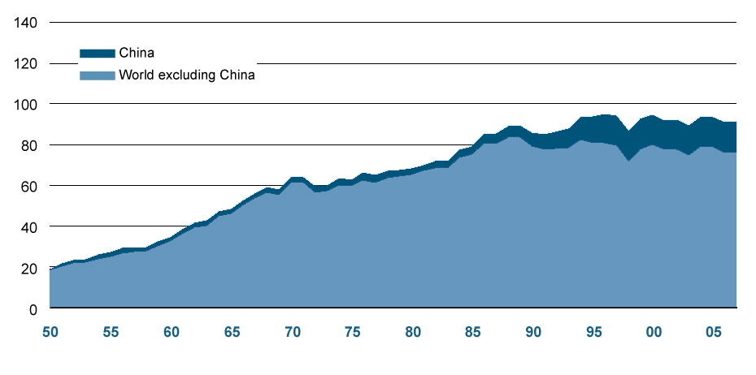
World capture fisheries production including freshwater (FAO, 2009)
Million tonnes

Slide 5
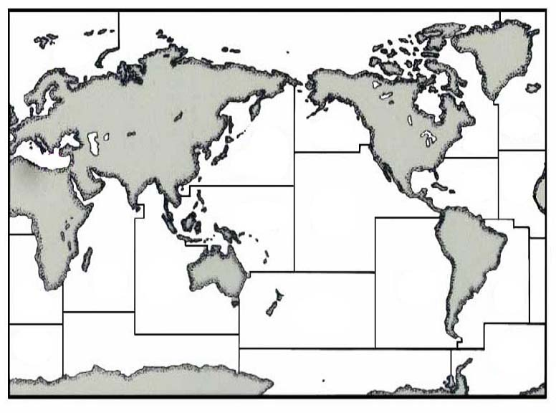
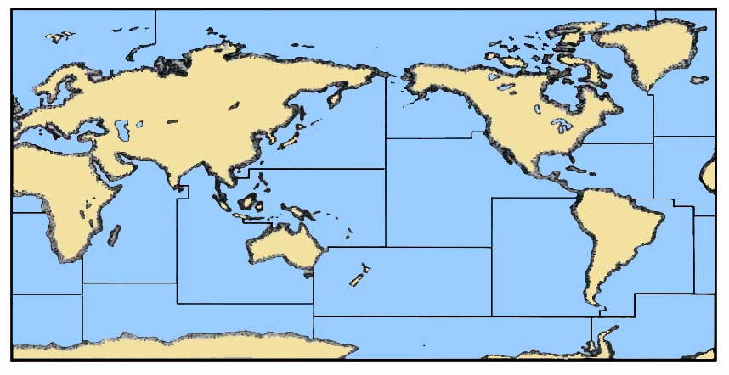

Catch by FAO marine fishing area (FAO, 2009)
11.3% / 4.0%
(0.63)
( ) : catch per unit area (t/km²)
Total catch (in 2007) = 81.2 million tons
2.2
9.1
3.6% / 2.1%
(0.38)
2.7% / 1.7%
(0.34)
20.3
3.0
25.0% / 6.0%
(0.99)
1.5
4.0% / 3.9%
(0.23)
1.9% / 4.0%
(0.10)
3.2
1.7
13.6% / 9.2%
(0.35)
2.0% / 13.3%
(0.03)
4.2
11.5
5.4% /8.5%
(0.15)
5.8
12.1
14.8% / 8.5%
(0.39)
2.5
1.4
0.6
1.8% / 5.1%
(0.08)
7.0% / 8.4%
(0.18)
0.8% / 7.7%
(0.02)
3.1% / 4.8%
(0.14)
0.01% / 3.5%
(0.001)
Notes:
5

Slide 6
Exploitation state
Out of 584 monitored stocks, 441 stocks (76%) were assessed
Of the 441 stocks,
77% fully- or over-exploited, depleted or recovering (85% in NW Pacific)
Increasing trend in % over-exploited stocks since 1974
(FAO, 2005)

Slide 7
Percentage of seafood as the source of animal protein
Japan 45.4%
Korea 39.9% NW Pacific 34.4%
China 18.0%
----------------------------------------------
Russia 12.7%
Canada 9.9% NE Pacific 9.7%
USA 6.4%
World Average 15.0%
(Data Source: FAO Food Balance Sheet)

Slide 8
Why ecosystem-based fisheries management?
Shortcomings of a single species management
- Lead to over-fishing in many areas
(77% fully-, over-fished: FAO (2005))
- Limited management: focuses only on sustainability, ignoring habitat and ecological interactions
Reykjavik Declaration (2002) and FAO (2003) stressed implementation of ecosystem approach to fisheries (EAF)
WSSD (2002) encouraged the application of the ecosystem-based approach of fishery by 2010

Slide 9
Spectrum of Ecosystem-based Management Approaches
(Modified from Sainsbury)
Traditional fishery management
Traditional fishery management
Traditional fishery management
Ecosystem-based fishery management
Ecosystem-based fishery management
Ecosystem-based multi-sector management
target species
start with the target species
add issues of ecosystem impact on fishery resources
start with the target species
add issues of ecosystem impact on fishery resources
integrated management
EBFA approach

Slide 10
Ecosystem-based fisheries assessment
Numerous studies on ecosystem indicators carried out
(Fulton et al. 2004; Jennings 2005; Kruse et al. 2006)
However, few approaches exist, synthesizing indicators to obtain an integrated assessment (ERAEF by Australia, MSC’s FAM, EBFA by Korea)

Slide 11
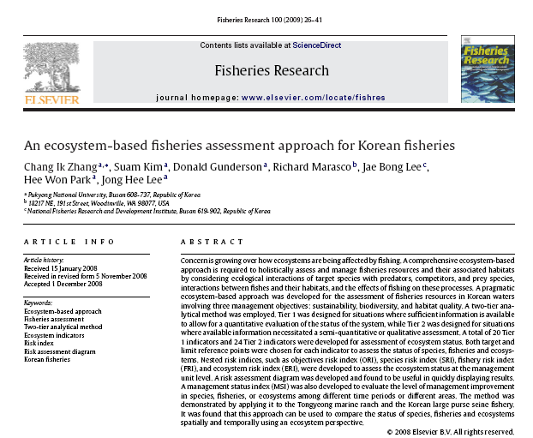

Slide 12
EBFA: 2 tier assessment system
Tier | Method | Level of information
 | Quantitative analysis | High
 | Semi-quantitative or Qualitative Analysis | Low
Notes:
12

Slide 13
Management objectives, attributes & indicators
S
H
Biomass
Fishing intensity
Size/age at first capture
Habitat size
Community structure
Habitat damage
Discarded wastes
Habitat protection
Sustainability
Habitat
E
B
Incidental catch
Discards
Trophic level
Diversity
Integrity of functional group
Economic production
Revenue
Market
Employment
Biodiversity
Socio-Economy
Notes:
13

Slide 14
We still have a long way to go …
From a practical standpoint, the ecosystem-based fisheries assessment approach (Zhang et al., 2009) is very appealing for its ability to incorporate a large number of quantitative ……..
……Yet, even this approach should be further refined, sensitivity analyses conducted, the forecasting version of this approach further developed, and future applications tested in other ecosystems…..
(Kruse et al., 2009, Fish. Res.)

Slide 15

Integrated Fisheries Risk Assessment, Forecasting and Management for Ecosystems (IFRAME)
An extension of EBFA (Zhang et al., 2009. Fish. Res.)

Slide 16
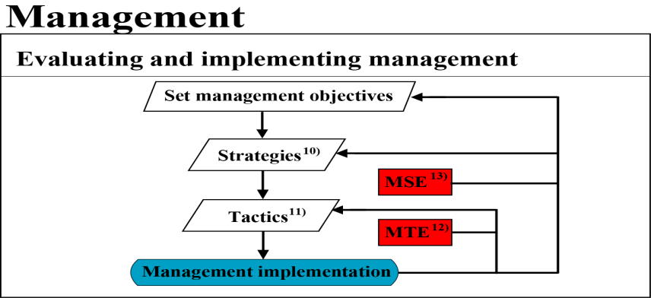
IFRAME :
in the developing stages

Slide 17
IFRAME- Assessment
1) SOM (Self-Organizing Mapping):
species grouping by swimming ability,
size, bone, depth, shape, habitat,
feeding, food type and longevity
2) Estimation of biomass and
production of LTL groups, i.e.,
phyto- and zooplankton
3) Biomass, catch, P/B, Q/B, DC
4) Ecosystem structure model
5) Ecological Process Studies on relevant
physical, chemical and biological
oceanographic processes
6) Fisheries and Socio-economic Assessment
7) Integrated Fisheries Risk Assessment,
Forecasting, and Management for
Ecosystems

Slide 18
IFRAME- Forecast
8) Ecosystem simulation model
for biomass
9) Based on management
index analysis

Slide 19

IFRAME- Management
10) Translate objectives to strategies,
‘what it will be done’
11) Translate strategies to tactics,
‘ how it will be done’
12) Management tactic evaluation
13) Management strategy evaluation

Slide 20
Application to the Korean large purse seine fishery
Target species : Common mackerel (Scomber japonicus)
Scenarios
Reference year : 2008
Forecasted year : 2013 (5 years later)
Forecasting risks by altering TAC of common mackerel based on 9 options :
no fishing, 40,000, 80,000, 120,000, 160,000(current level), 200,000, 240,000, 280,000, 320,000 mt

Slide 21
Changes in Total Allowable Catch
Fishing intensity (effort)
Bycatch
& Discards
Diversity
Pollution
rate
Discarded
wastes
Lost
fishing gear
Catch amount
Biomass
Mean TL in
catch and community
Recruitment
Habitat size
Size at first capture
Rate of
mature fish
Size at maturity
Habitat
damage
Market, Production & Revenue, Employment

Slide 22
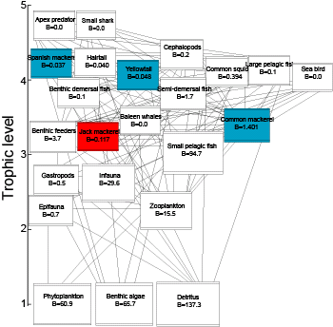
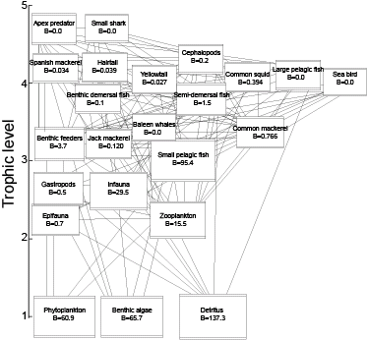
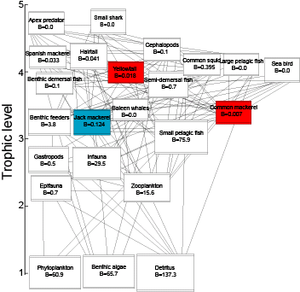
2013
No fishing
2008
TAC= 160,000mt
Biomass of exploited species
Increase: Common mackerel, Yellowtail,
Spanish mackerel
No change: Common squid, Hairtail
- Decrease: Jack mackerel
TAC= 320,000mt
Biomass of exploited species
Increase: Jack mackerel
No change: Common squid, Hairtail,
Spanish mackerel
Decrease: Common mackerel, Yellowtail

Slide 23
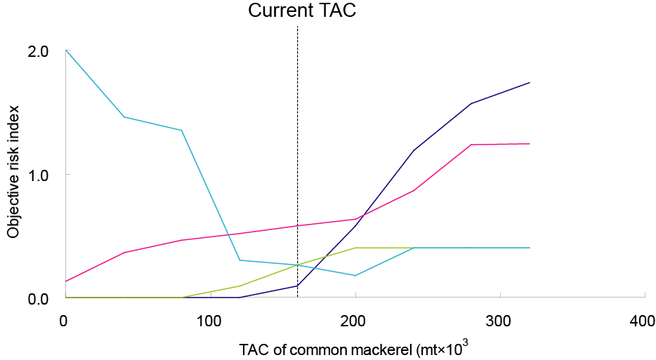

Forecasted ORIs for common mackerel by changing TAC in 2013

Slide 24
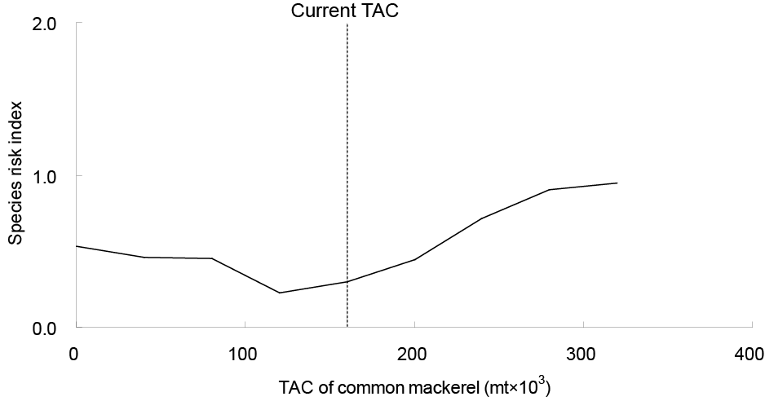
Forecasted SRI for common mackerel by changing TAC
eTAC < TAC
Objective | No fishing | 40,000 | 80,000 | 120,000 | 160,000 | 200,000 | 240,000 | 280,000 | 320,000
SRI | 0.53 | 0.46 | 0.45 | 0.23 | 0.30 | 0.45 | 0.71 | 0.90 | 0.95

Slide 25
IFRAME is still in the developing stages
Preliminary results indicate that this approach has potential as a tool for forecasting risk indices of objectives, species and fisheries
However, it is still far from practical applications due to lack of knowledge for assessing risks of a number of indicators
Further research on indicators and reference points is required, and more ecological process studies, such as ecological interactions with physical factors, impacts on climate changes, are essential.

Slide 26
Approach to scientific need for EBFM
      We need strengthen links among
Meteorological & environmental sciences
Fisheries
sciences
Integrated
multidisciplinary
programs
PICES
Physical, chemical & biological oceanography
Socio-economic sciences

Slide 27
In conclusion
Under the current situation of changing climate, degraded ecosystems and depleted stocks, a management system for holistic ecosystem approaches needs to be properly established.
Since EBFAF requires multi-disciplinary research, it will be desirable for neighboring countries to conduct cooperative studies for the Yellow Sea LME
Notes:
27

