Slide 1
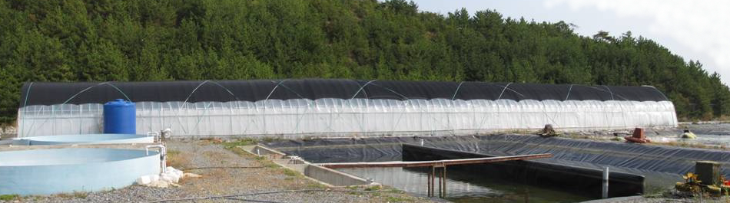
SUPER-INTENSIVE SHRIMP CULTURE USING NO WATER EXCHANGE
The 2nd YSLME Regional Science Conference, Xiamen, China, 24-26 Feb, 2010
In Kwon Jang
West Sea Mariculture Research Center
National Fisheries Research & Development Institute,
South Korea
Notes:
I’m In Kwon Jang working at CRC
I would like to say about status…
This work is part of YSLME project

Slide 2
BACKGROUND
Shrimp culture is one of the most important aquaculture activities along the Yellow Sea coast of South Korea and northern China.
  Farmed shrimp production (2004): 1,179 MT (Korea) and 150,000 MT (China)
  Shrimp cultured using flow-through method in earthen ponds.
Discharged water causes coastal eutrophication.
  Three billions m³ of seawater (20 m³ of water /kg of farmed shrimp)
Pathogen transmission via water exchange (Lightner, 2000).
  Frequent mass mortalities of shrimp due to viral infection
  In 2004, 32.9% out of 468 shrimp farms in Korea were collapsed because of WSSV or other viral outbreak
Limited water-exchange shrimp culture can reduce viral introduction and negative environmental impact created by traditional pond method.

Slide 3
Farmed Shrimp Production of Korea and China in Yellow Sea

Slide 4
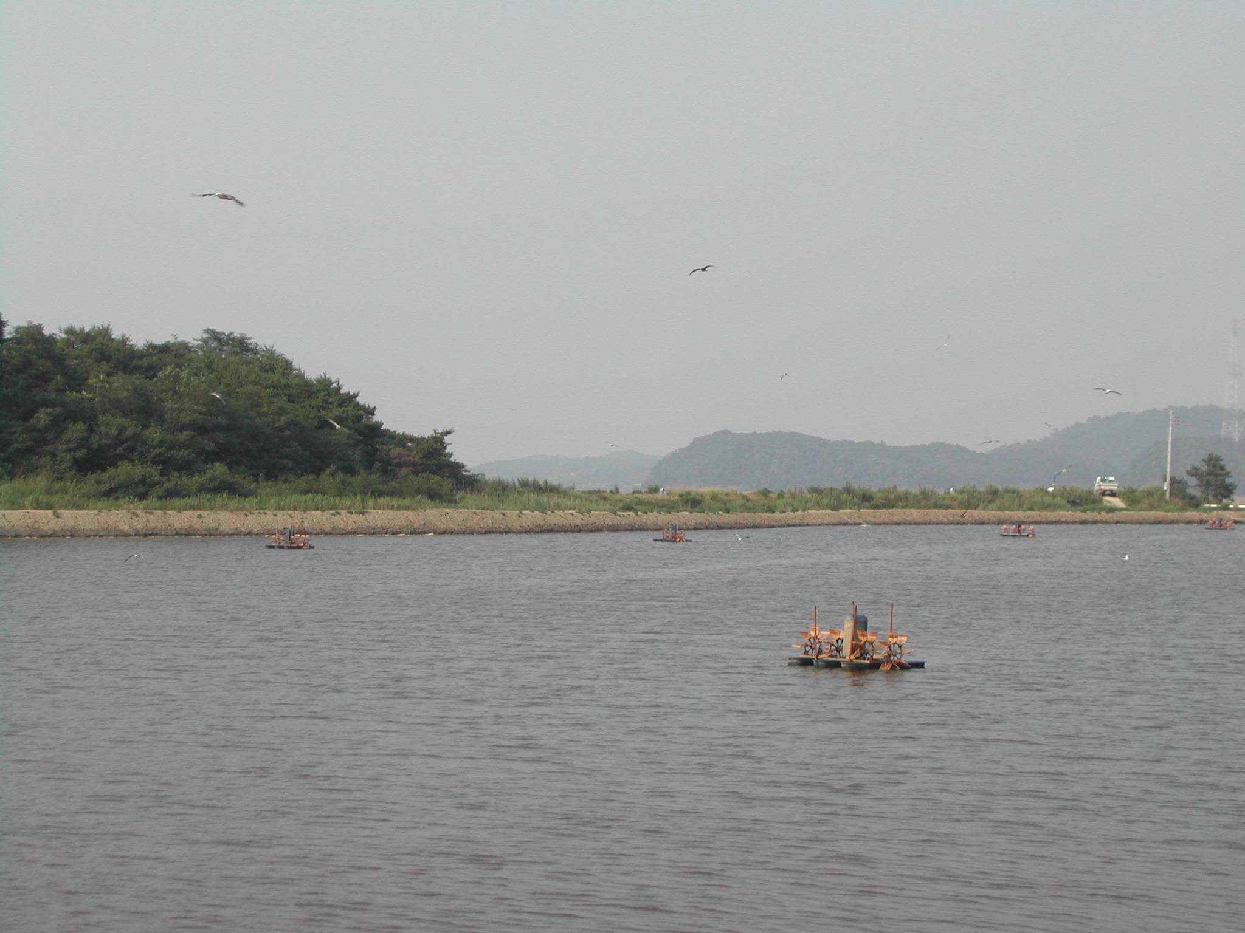
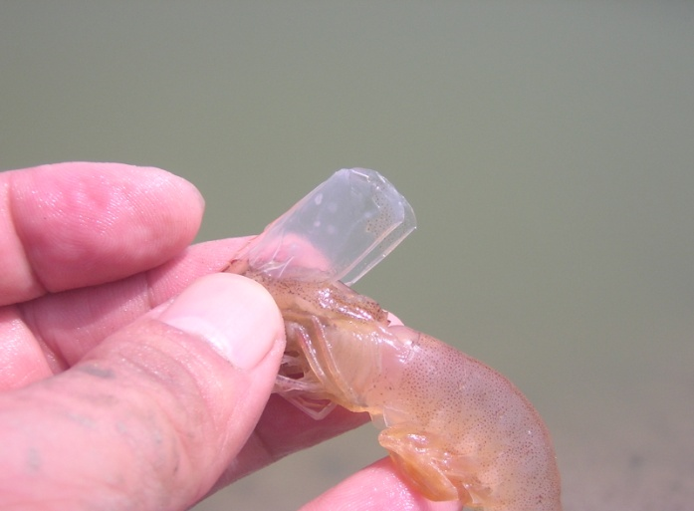
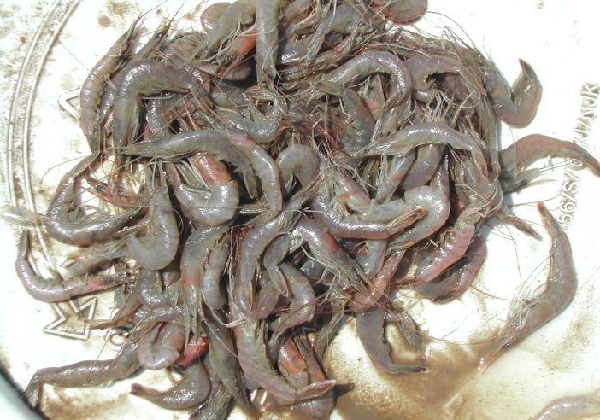
WSSV (white spot syndrome virus), the Biggest Problem

Slide 5
How to remove ammonia
In intensive aquaculture system, ammonia build-up from the metabolism of feed is the most important limiting factor for increasing production
The three pathways removing ammonia-nitrogen
  Photoautotrophic pathway by phytoplankton
  Autotrophic bacterial conversion from ammonia to nitrite and nitrate
  Heterotrophic bacterial conversion from ammonia directly to microbial protein
Under limited water-exchange and suspended organic particulates
  Autotrophic bacterial community shift to heterotrophic bacterial community
  Using organic carbon, heterotrophic bacteria assimilate ammonia to produce bacterial cellular protein
  Bacteria form bioflocs with particulate matters
  Bioflocs are fed by shrimp as additional food source (Avnimelech, 2006).

Slide 6



Two Pathways Removing Ammonia-Nitrogen
Feed(C, N)
N2
Recirculating Aquaculture System (RAS)
Uneaten feeds are removed by filters. Toxic ammonia is converted into less toxic nitrogen compound by autotrophic bacteria. Water exchange is 5%/day
NO3
CO2
Nitrobacter
NO2
C
Nitrosomonas
Non-utilized C, NH4
NH4
(culture tank)
sludge(C, N)
(biofilter)
Feed(C, N)
Organic Carbon
Biofloc technology(BFT)
Uneaten feeds are kept in tank. Bacteria form bioflocs which are consumed by shrimp.
Water exchange is less than 1%/day
NO3, CO2
Bacterial protein
Non-utilized C, NH4
Hetertrophic bac(biofloc)
(C, N protein)

Slide 7
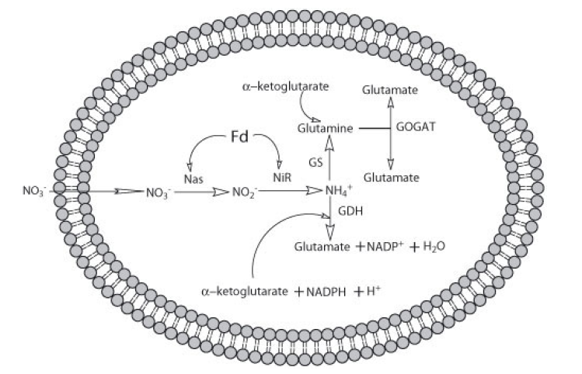
Ammonia Assimilation Pathway by Heterotrophic Bacteria
High ammonia availability : GDH pathway NH₃ + 2-oxoglutarate + NADPH + H⁺ <---> glutamate + NADP⁺ Low ammonia availability : GS-GOGAT pathway NH₃ + glutamate + ATP ---> glutamine + ADP + Pi glutamine + 2-oxoglutarate + NADPH + H⁺ ---> 2 glutamate + NADP⁺ Dual pathway: bacteria, cyanobacteria, algae, yeast, fungi etc
Assimilatory nitrate reduction in Hfx mediterranei.
Nas: assimilatory nitrate reductase; NiR: assimilatory nitrite reductase; Fd: Ferredoxin; GDH: glutamate
dehydrogenase; GS: glutamine synthetase; GOGAT: glutamate synthase

Slide 8
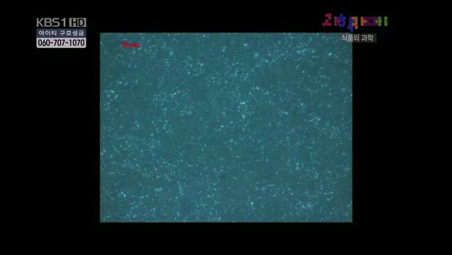
Biofloc formation

Slide 9
OBJECTIVES
To develop a prototype for demonstration farm of commercial-scale greenhouse-enclosed super-intensive shrimp production system under no water exchange,
To develop shrimp culture technologies to enhance production, minimize viral transmission and reduce environmental pollution, and
To implement the technology to private sectors for commercialization

Slide 10
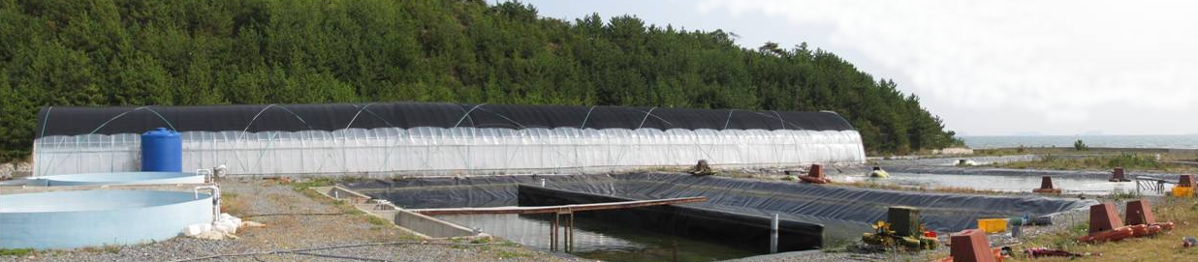
Shrimp Production System
Greenhouse-enclosed shrimp production system
  West Sea Mariculture Research Center (WSMRC), Taean, Korea in 2008.
  Greenhouse (1,000 m²): two LLDP-lined raceway tanks (300 m² each)
  Oxygen generator, venturi system, water pump, air blower and air lift etc
  Water was heated by heat-exchanger using underground water.

Slide 11
Water preparation and Stocking
Water preparation
  Seawater (34 psu) filtered through 100 and 10 uM and chlorinated (20 ppm)
  Fertilized with urea, phosphoric acid and sodium and inoculated with diatoms
  Water was not exchanged during 152 days: freshwater added to offset evaporation.
  Providing 2-5 L of molasses as additional carbon source
Postlarvae of SPF(specific pathogen free) L. vannamei were cultured in nursery tanks for 16 days (Mar. 17 to Apr. 2, 2009)
On April 2, nursery-cultured juveniles were stocked to raceways
Feed management
  EP diet (CP 30%) three times a day
  Amount of feeds were based on feed consumption, gut fullness, WGR, FCR

Slide 12
Analysis
Water quality analysis
  DO, pH, salinity, turbidity and water temperature daily measured.
  Alkalinity, TAN (total ammonium nitrogen), nitrite–N, nitrate–N, chlorophyll-a, total suspended solids (TSS), and volatile suspended solids (VSS) weekly
Bacterial count
  The number of total bacteria was counted using DAPI (4,6-diamidino-2-phenylindolole) fluorescent staining method
  The number of Vibrio were counted weekly.
Measuring immune activity of shrimp
  Shrimp cultured in biofloc water of different conc. (0, 15, 150, 75, 100%)
  Growth rate, FCR
  Heamolymph kind (THC, GC, SGC, HC) and PO (phenoloxidase) activity
Economic analysis

Slide 13
Stocking and Production of Shrimp
Table. Summary of stocking and production of Pacific white shrimp culture under no water exchange condition for 152 days
 | Initial B.W.(g) | Stocking density(/m²) | Days | Final B.W. (g) | Yield (kg/m²) | Total harvest(kg) | Survival rate(%) | FCR
Tank1 | 0.038 | 408 | 152 | 15.17 | 5.47 | 1640 | 88.30 | 1.22
Tank2 | 0.038 | 404 | 152 | 13.6 | 4.03 | 1210 | 73.43 | 1.32
Water use 0.2 m³/ kg of shrimp production (20 m³ in flow-through method)
Productivity 5.47 kg/m² (0.15-0.3 kg/m² in traditional method)
Survival rate 88.3% (40-50% in traditional ponds)
FCR 1.22 (about 1.7-2.0 in traditional method)

Slide 14
Growth rate of shrimp
Fig. Change of body weight in Pacific white shrimp, L. vannamei cultured in greenhouse- enclosed super-intensive grow-out systems under no discharge for 152 culture trial

Slide 15
Summary of Water Quality
Table. Mean and ranges of selected water quality parameters in greenhouse-enclosed super-intensive grow-out systems under no discharge for 152 culture trial
 | W.T. (℃) | DO (mg/L) | Salinity (psu) | pH | TAN (mg/L) | NO₂-N (mg/L) | NO₃-N (mg/L) | Chl-a (㎍/L) | TSS (mg/L) | VSS (mg/L) | Alkalinity (mg/L)) | Turbidity (NTU)
Tank 1 | 28.5 24.7-30.4 | 6.1 3.7-8.6 | 32.7 30.5-36.0 | 7.2 6.2-8.4 | 0.7 0.0-3.5 | 5.9 0-31.8 | 94.4 0.1-210.8 | 223.9 19.4-409 | 694.7 149.2-1223 | 244.3 42.4-426 | 99 50-170 | 138.7 9.8-250.9
Tank 2 | 28.6 24.8-30.2 | 6.2 4.7-9.0 | 32.8 30.0-36.1 | 7.2 6.3-8.4 | 0.8 0.0-3.7 | 4.1 0-21.9 | 66.2 0.0-155.0 | 218.2 14.5-356 | 565.0 154.8-943 | 204.5 41.0-376 | 99.7 60-160 | 130.8 11.2-238

Slide 16
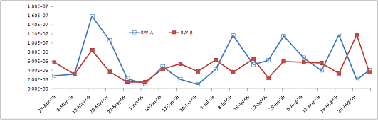
Bacterial Counsts
Total number of bacteria was 5.69 x 10⁶ (9.95 x 10⁴ - 1.59 x 10⁷) and 4.87 x 10⁶ (1.42 x 10⁶ - 1.18 x 10⁷)/mL in tanks 1 and 2 respectively.
It suggests that that microbial community in the culture system shifts from autotrophic bacteria dominated community

Slide 17
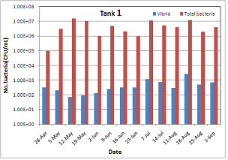
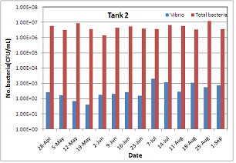
Ratio of Vibrio to total bacterial number
The number of Vibrio was mean 5.55×10² and 5.51×10² CFU/mL
The ratio of Vibrio to total bacterial counts was very low, about 10⁻⁴.

Slide 18
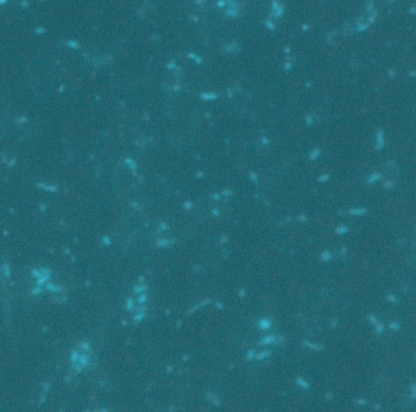
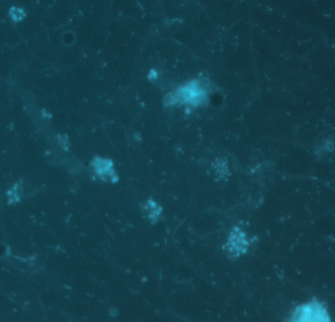
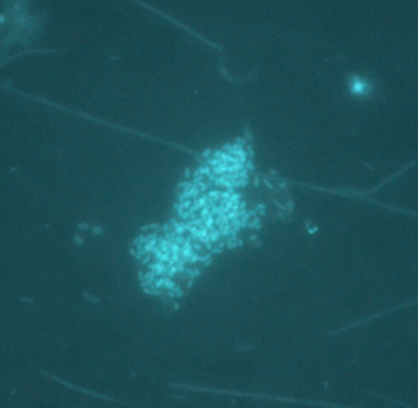
Bacteria forming Biofloc
Fig. DAPI-fluorescent microscopic photographs of bacteria in super-intensive shrimp culture system using no discharge method. Individual bacteria (left) are forming bacterial flocs (right) (×1,000).

Slide 19
Effects of biofloc water on shrimp growth and immune activity
Table. Summary of growth, FCR and survival rate in five experimental groups during a 63-day culture trial with Pacific white shrimp
 | Biofloc 100% | Biofloc 75% | Biofloc 50% | Biofloc 25% | Control
Initial B.W.(g) | 1.69 | 1.69 | 1.69 | 1.69 | 1.69
Final B.W.(g) | 9.21 | 11.12 | 10.87 | 10.85 | 8.72
Total biomass (g) | 546.2 | 592.7 | 626.1 | 621.7 | 497
Consumed feed (g) | 793.9 | 980.2 | 857.4 | 860.2 | 846.9
FCR | 1.45 | 1.65 | 1.37 | 1.38 | 1.70
Survival rate (%) | 98.8 | 88.8 | 96 | 95.5 | 95.0

Slide 20
Ratio of haemocytes in different biofloc groups
Fig. Relative percentages of haemocyte types from L. vannamei reared in biofloc mixed water. GC : granular cell, SG: semigranular cell, and HC: hyaline cell.

Slide 21
PO activity in different biofloc groups
Fig. Change of prophenoloxidase (PO) activity in haemocyte of L. vannamei reared in various biofloc mixed water systems. Bars with different letters are significantly different (p<0.05).

Slide 22
Economic Analysis
Key factors for base scenario
  Production inputs, financial and shrimp selling price
Parameters for analysis required
  Land (own, rent or purchase)
  PL, Feed, Energy, Labor, Oxygen
  Shrimp price variation
  Survival, stocking density, Growth Rate
  Financial: support from government or loan from bank

Slide 23
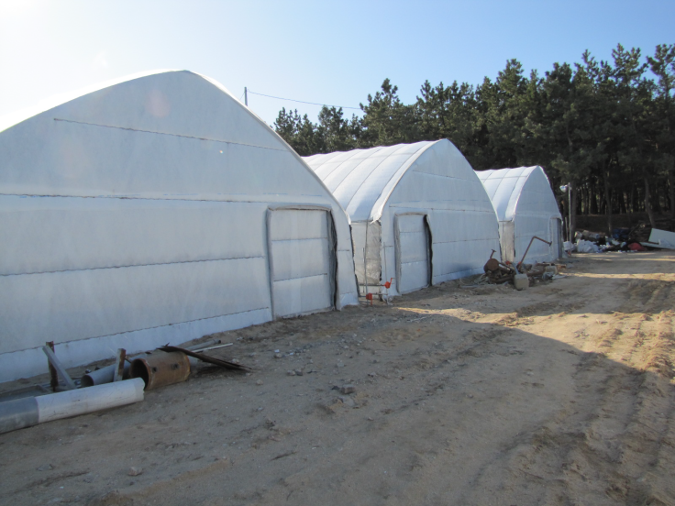
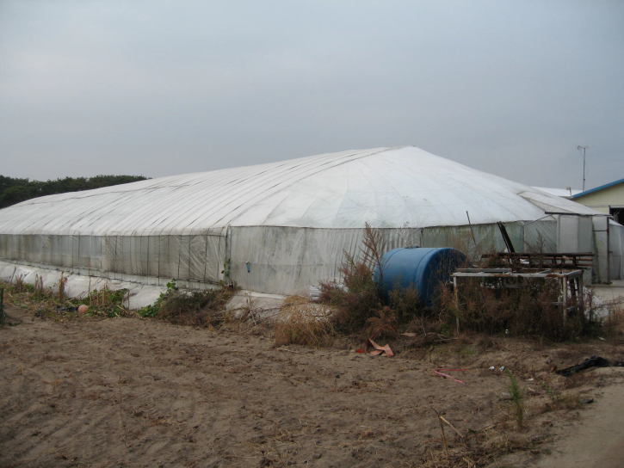
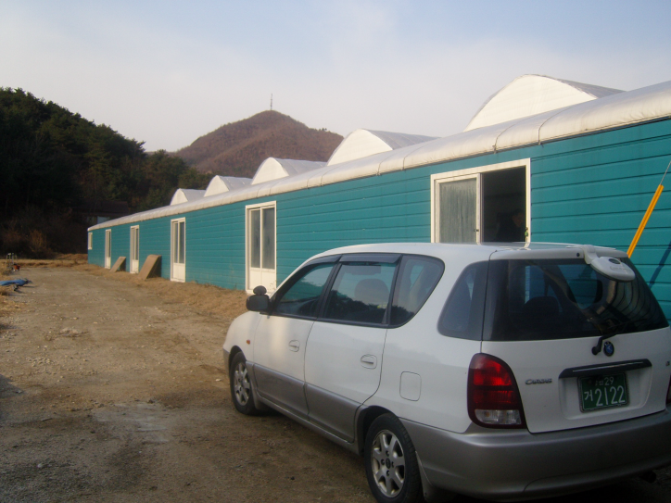
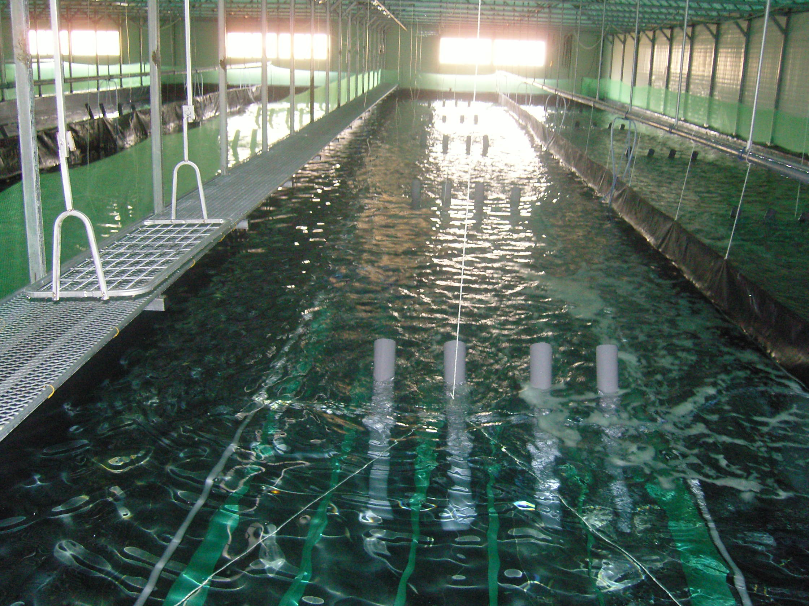
Implementation of new technology to farmers

Slide 24
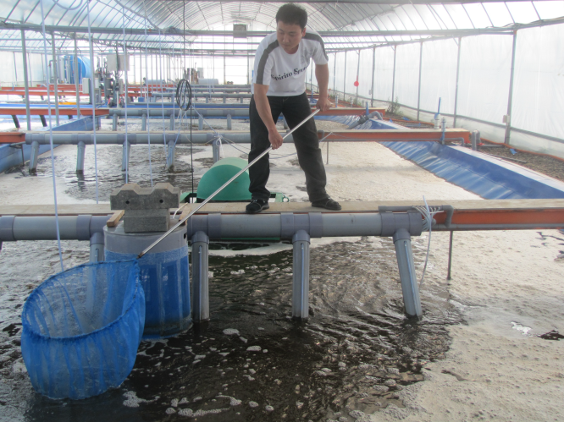

Slide 25
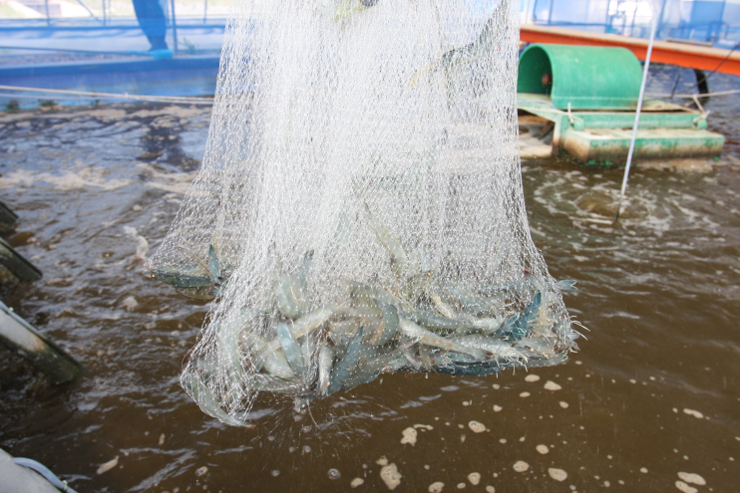

Slide 26
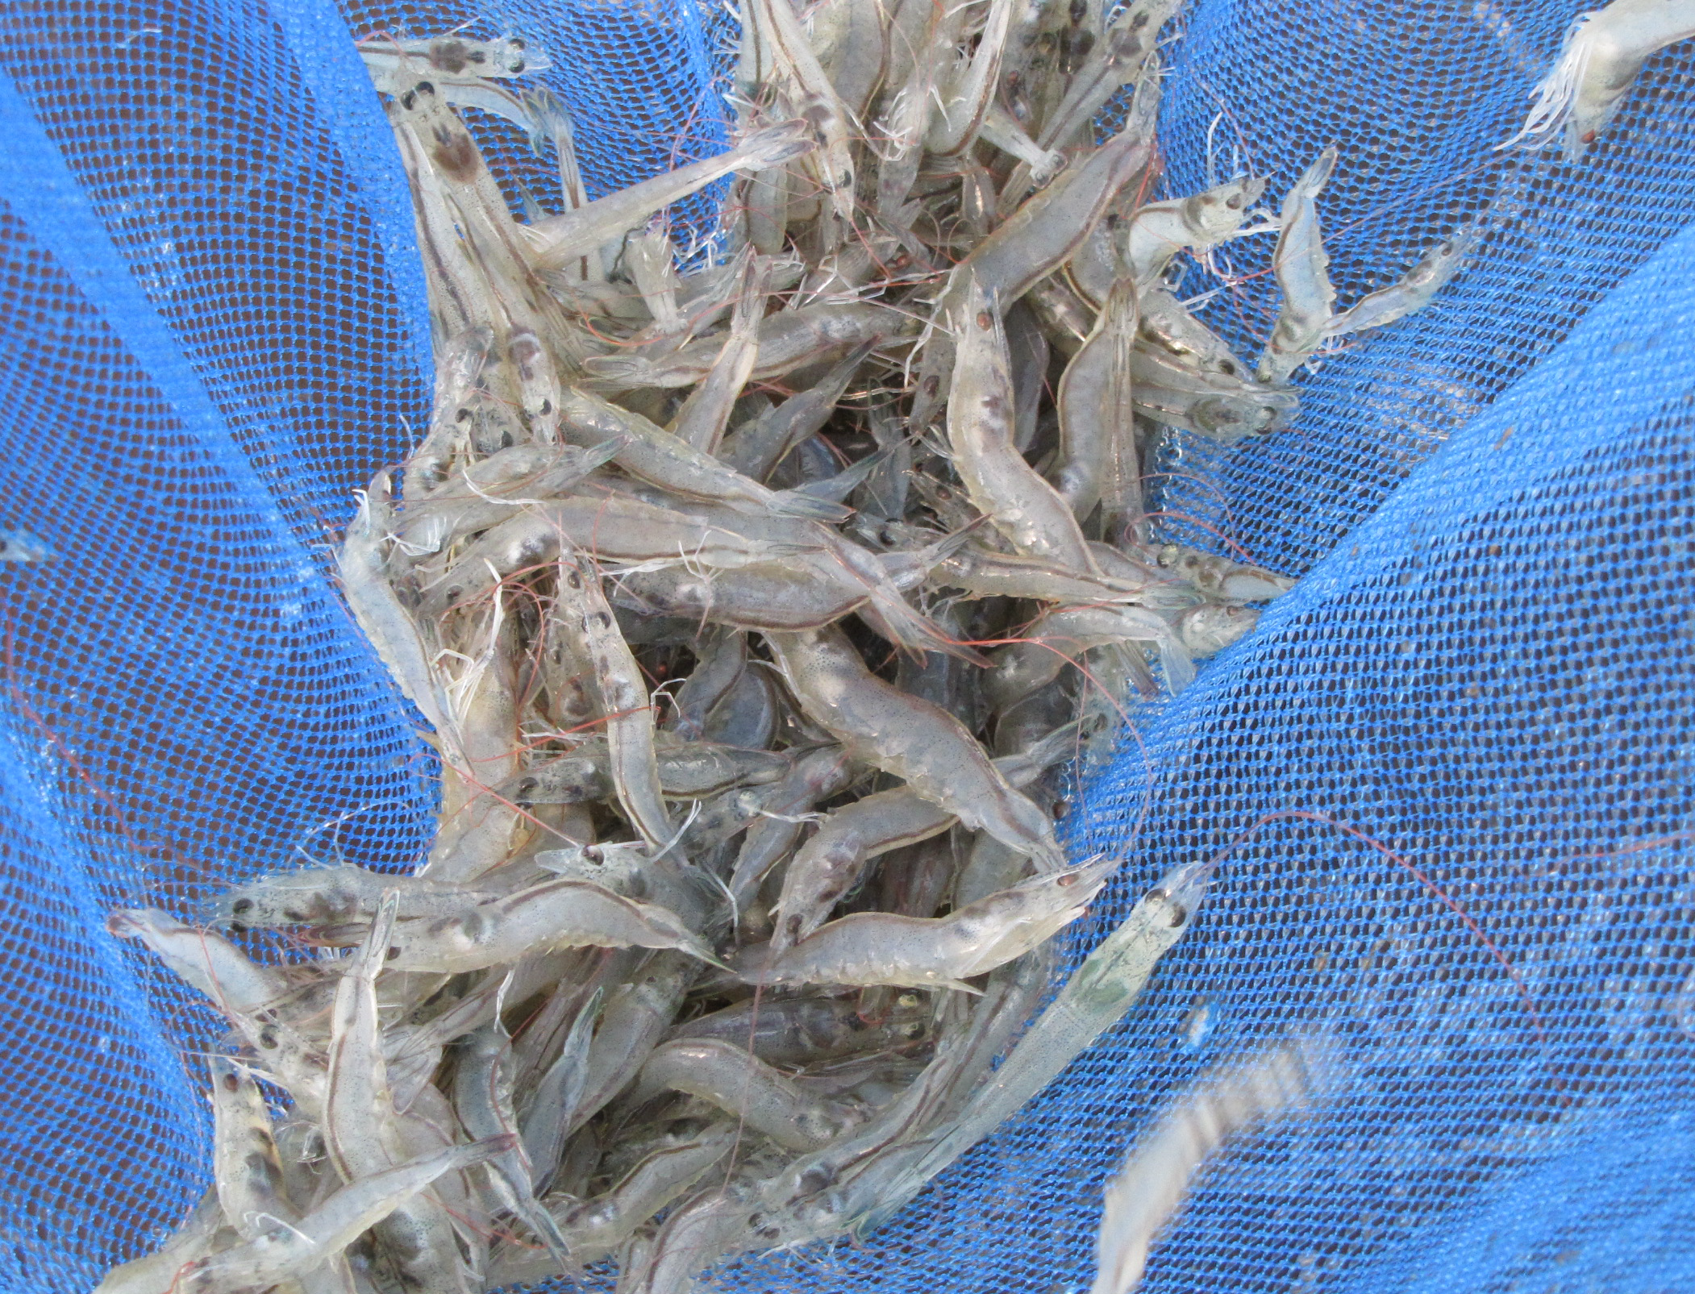

Slide 27
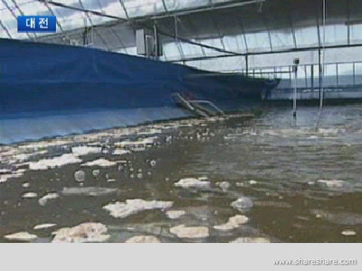

Slide 28
SUMMARY
Shrimp culture is one of the most important aquaculture activities in the Yellow Sea coast of Korea and northern China.
The most shrimp farms in these areas in both countries are semi-intensive in earthen ponds using conventional flow-through method.
This method discharges huge amount of waste water, causing coastal eutrophication and introduce viral pathogens via water-exchange, resulting mass mortalities of farmed shrimp.
The objectives of this study are to demonstrate shrimp culture practices to enhance production as well as to reduce negative environmental effects in the Yellow Sea.

Slide 29
SUMMARY
In the present study, super-intensive shrimp production trials were conducted in commercial-scale greenhouse-enclosed system under no water exchange condition.
The present study demonstrated
  Water use (discharge) reduced up to 98-99%
  Production per area increased up to 20 times/crop or 50 times/year
  Pathogen (viral) transmission from environment controlled
  FCR decreased by 30-40%
  Immune activity increased up to 314%(based on pilot experiment)
Economic analysis suggested that commercialization of the technology is feasible when some limitations are solved

Slide 30
SUGGETION
Limitations need to be solved for commercialization
  Practical manual and standard criteria for properly managing the production system for farmers have to be prepared.
  Shrimp postlarvae/juveniles can be provided for farmers whenever they need to stock.
  Related technologies should be developed, such as high efficient diets, methods saving energy cost for heating water, design of production system and so on.
Next phase is to apply the technology to land-based finfish culture

Slide 31
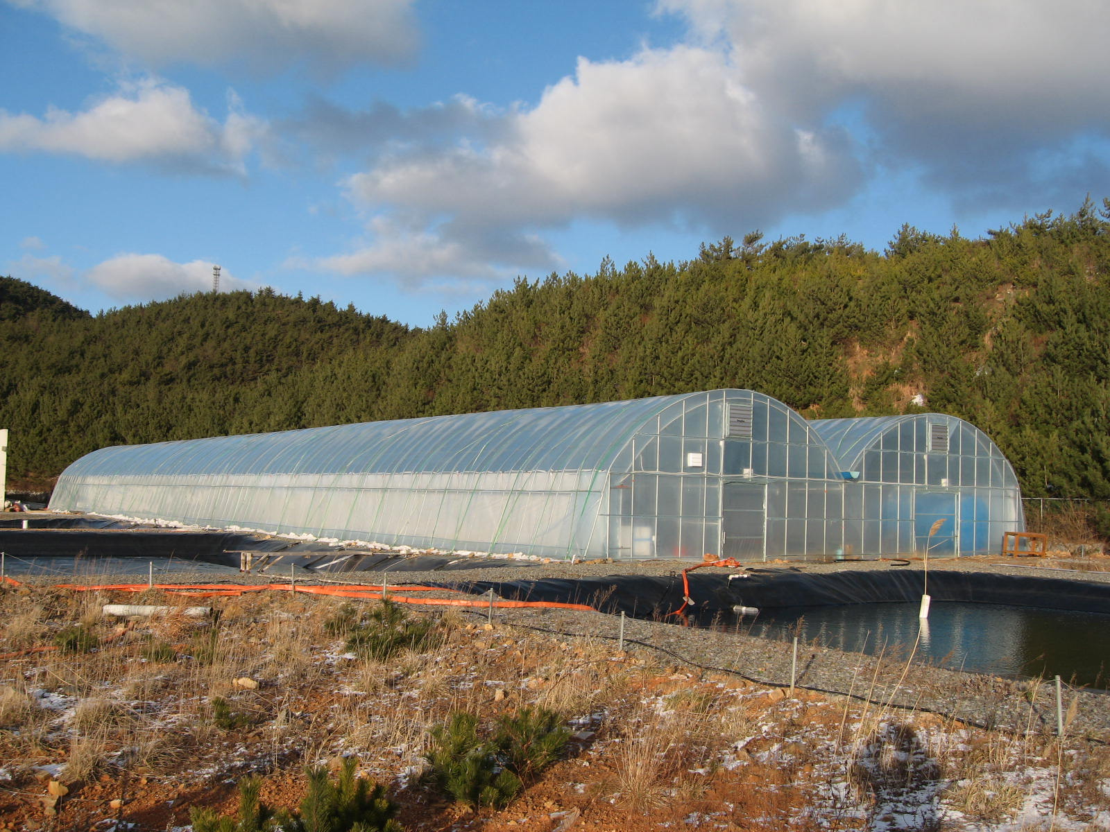
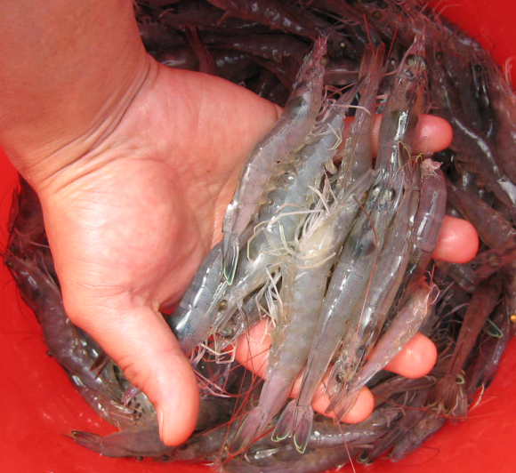
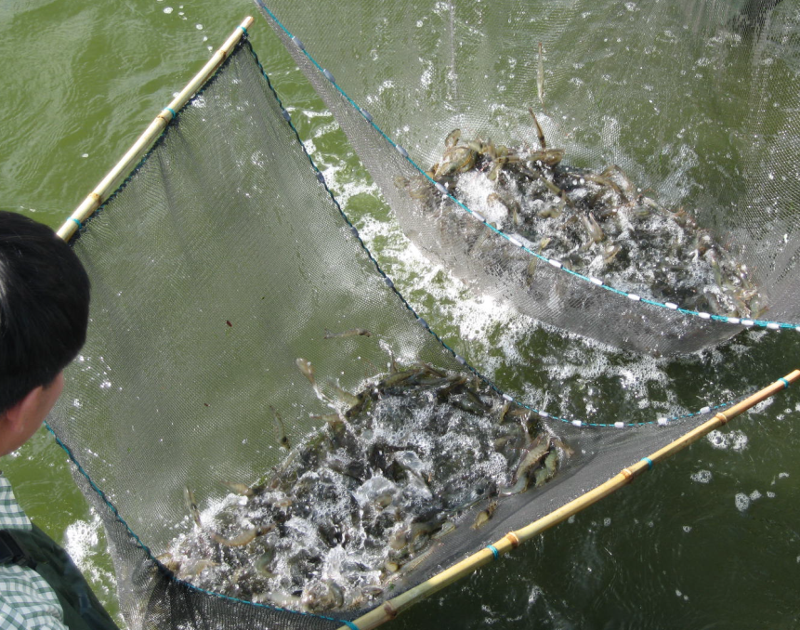
Enhancing Production
Minimizing Viral Diseases and
Reducing Environmental Pollution

